Slide 1
Suicide Analysis By Young, Yalun, Jijie, Kwan

Slide 2

Background
With COVID-19 still remaining severe around the globe, many people are living in an insecure and abnormal life. The most severe and common consequence of painful stress, caused by this pandemic, is committing suicide.

Slide 3

Background​
Because suicide for every age group is heavy, engaging in a conversation and research about suicide rates with other factors can be valuable and applicable.​ This report analyzes potentially associated factors. Through an examination of factors affecting suicide, we will show that GDP per capita is not the crucial factor whereas the age and gender associate with suicide rate; factors "higher age" and "male" will lead to higher suicide rate.​

Slide 4
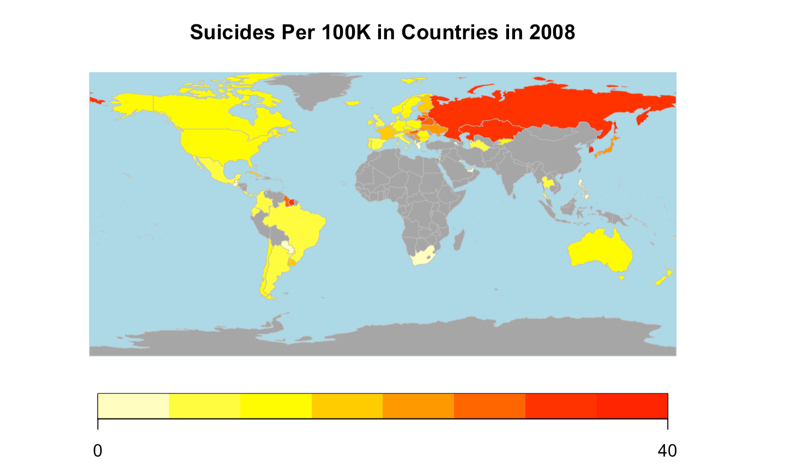
The data set is collected from Kaggle.
Rusty. "Suicide rates Overview 1985 to 2016." Kaggle, December 01. 2018, Retrieved April 10, 2021, from https://www.kaggle.com/russellyates88/suicide-rates-overview-1985-to-2016.

Slide 5
Does Suicide Rate associate with Person’s Wealth?

Slide 6
GDP Per Capita
Low wealth is a main cause of suicide.
Low GDP Per Capita means low per capita wealth, such that some people may be unemployed and have financial problems.
Such people may choose to commit suicide.
Possible Assumption:
Low GDP -> Low per capita wealth -> financial problems -> higher suicide rate

Slide 7
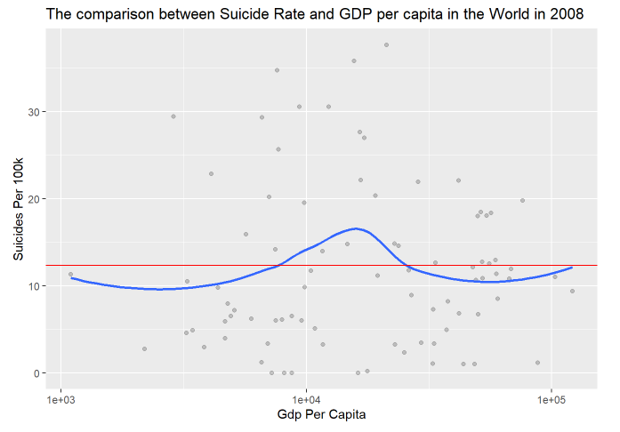


Scatter plot, Hypothesis test, and Linear model on assumption

Slide 8
GDP Per Capita
However, from the analysis, we found that there is a no association between wealth and suicides.
Therefore, we speculate that GDP per capita may not be an indicator directly related to the core causes of suicide, because some companies may falsely report economic data in order to evade taxes, which will lead to the inaccuracy of GDP, so we continue to analyze age and gender.

Slide 9
Does Suicide Rate associate with Age?

Slide 10
Mental Stress
Mental Stress is another main cause of suicide.
Mental Stress can come from everywhere like workplace, family issue and studying.
As people age, they are more likely to have more pressure from life and from taking painful and continuous therapies for curing illness.
Possible Assumption:
Older people -> more mental stress -> higher suicide rate

Slide 11
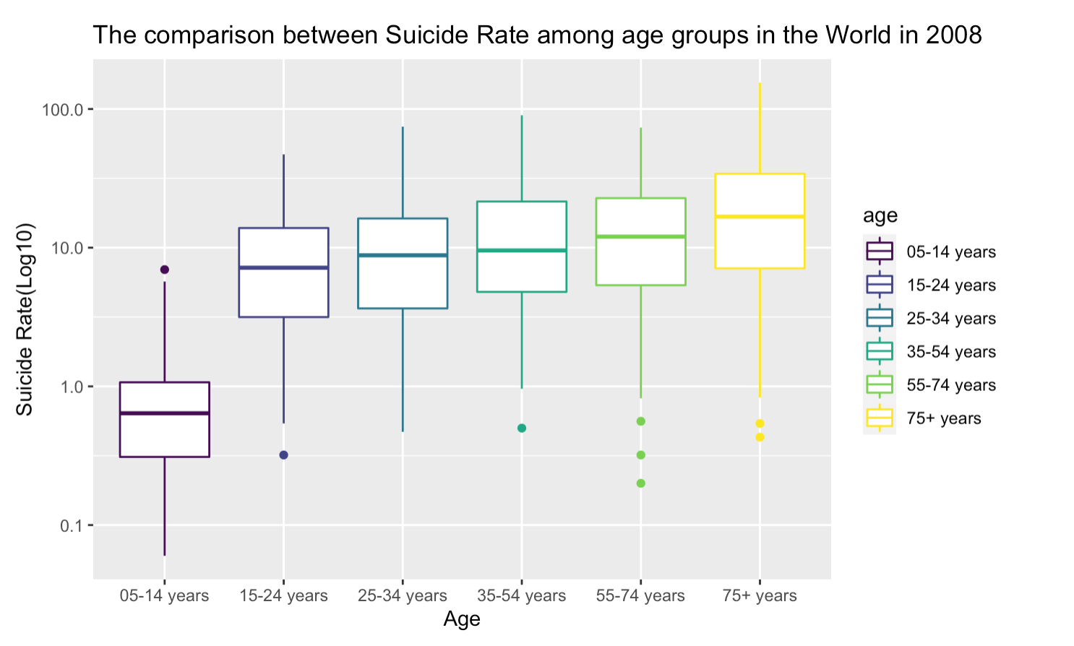
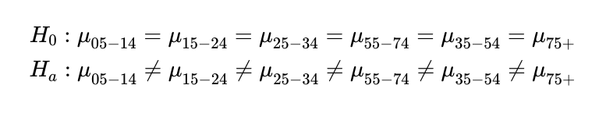
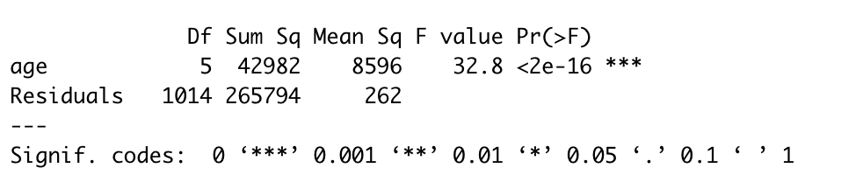
Box plot and Anova test on assumption

Slide 12
Does Suicide Rate associate with Gender?

Slide 13
Gender
One main cause of suicide is traumatic experience.
Females may have more traumatic experience like sexual abuse or physical abuse than those of males.
Possible Assumption:
Females -> more traumatic experience -> higher suicide rate

Slide 14
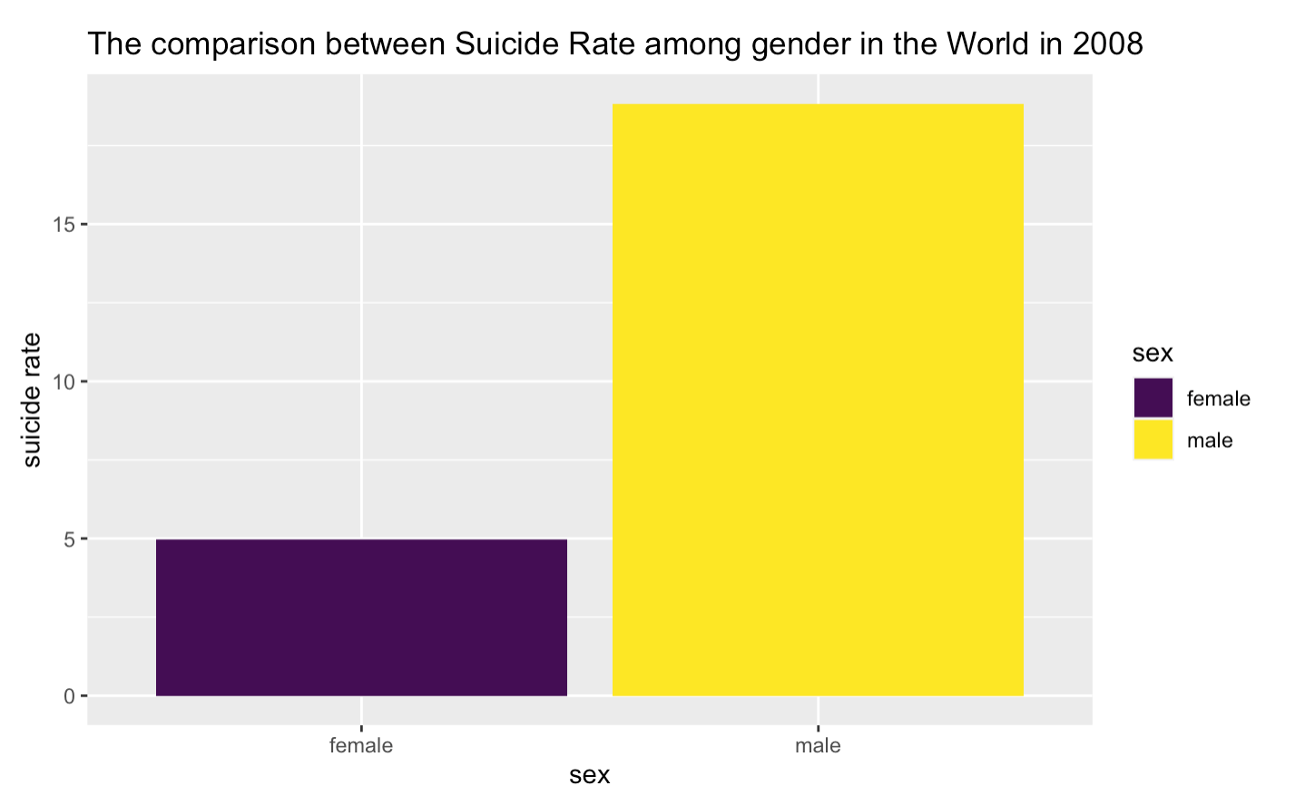

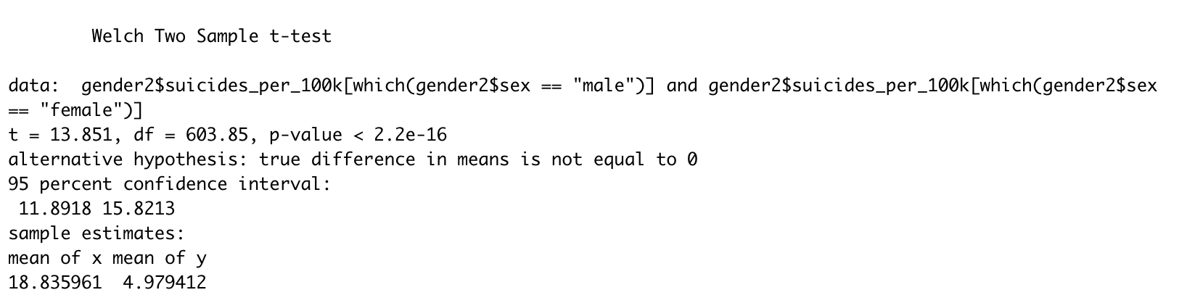
Bar plot and T test on assumption

Slide 15
Quick recap
1. GDP per capita vs Suicide Rate
Our initial assumption that lower GDP per capita leads to higher suicide rate is invalid.
Our data suggests there is no direct association between GDP per capita and the suicide rate.
This tells us even country with high GDP could experience high suicide rate,
poverty is not the only source for the people to commit suicide.

Slide 16
In conclusion,
GDP per capita is not a good indicator to measure suicide rate.
Our analysis showed GDP per capita has no association with suicide rate.

